Slide 1
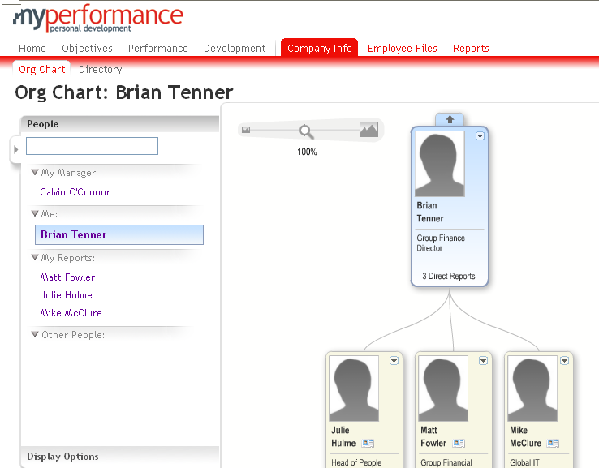
Exploring the Company Info Tab
Provides an overview of your team structure
Use the slide rule to alter the size of the picture

